Slide 1


SnapRoot
Terry Fei
Selina Fung
Maureen Naff
Bhavin Goswami
Will Liu
AI for equitable and personalized nutrition in diverse US communities
Notes:
“Hi everyone, thanks for being here. Today we’re presenting ‘The Pursuit of Happiness’ — looking at what 100 years of research says about what really makes us happy. Spoiler alert: it’s not what you might think.”

Slide 2

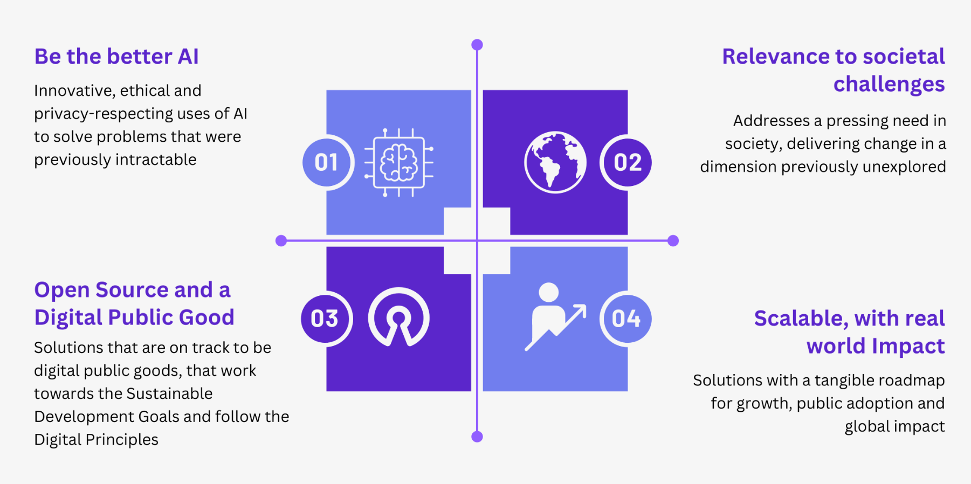



Our success criteria
Omni-channel
We maintain the unbiased, ethical nature of AI and reduce the amount of hallucinations with guardrails
Health disparity, food insecurity, cultural barriers with multi-language
Open Source models -
Llama 3 and Mistral
Open Source data -
NYC Open Data sets
Inclusive Digital Principles to share, reuse and improve
Multi-Linguistic
Scalable and rolled out nationally in initial phase

Slide 3
Problem Statement
SNAP Helps Buy Food. It Doesn’t Help Decide What to Eat
SNAP covers food costs but not the complex, personal decisions people face around nutrition. Many lack access to affordable, culturally relevant, and medically appropriate food, along with practical guidance.
SnapRoot is our solution
Why it matters
Even high income countries face nutritional barriers
‹#›
Notes:
“We all want to be happy. But what does that even mean? This project helped us explore not just what happiness is, but how we can find it. And the answer turned out to be less about success — and more about the people around us.”

Slide 4
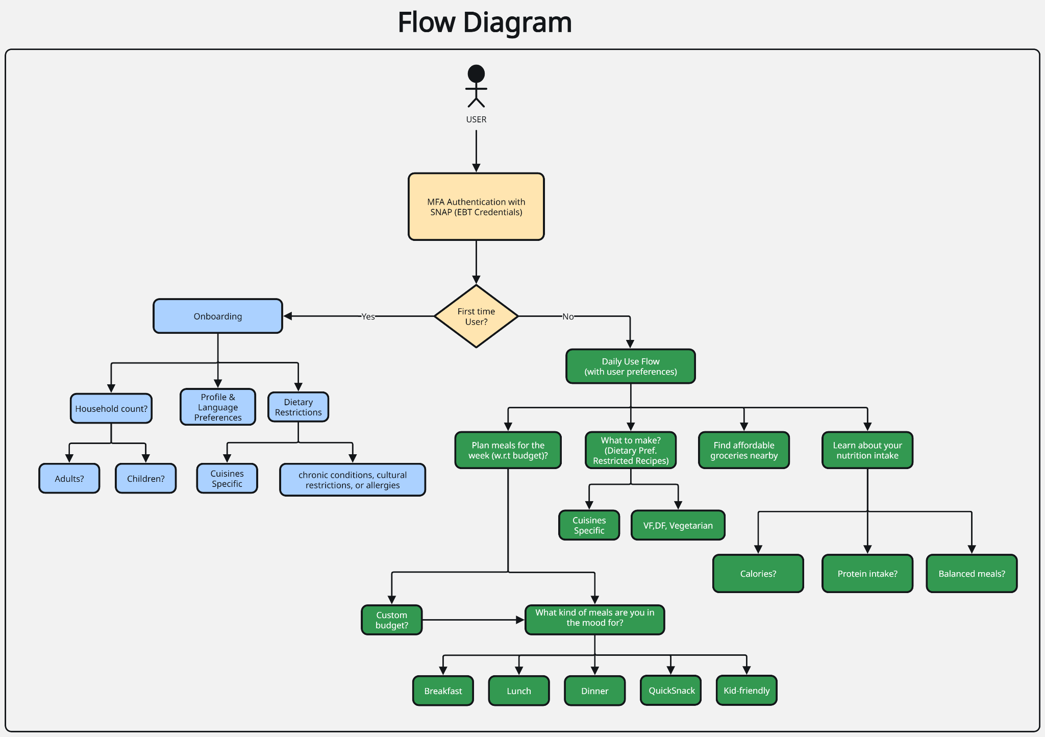

SnapRoot User
Process Flow

Slide 5
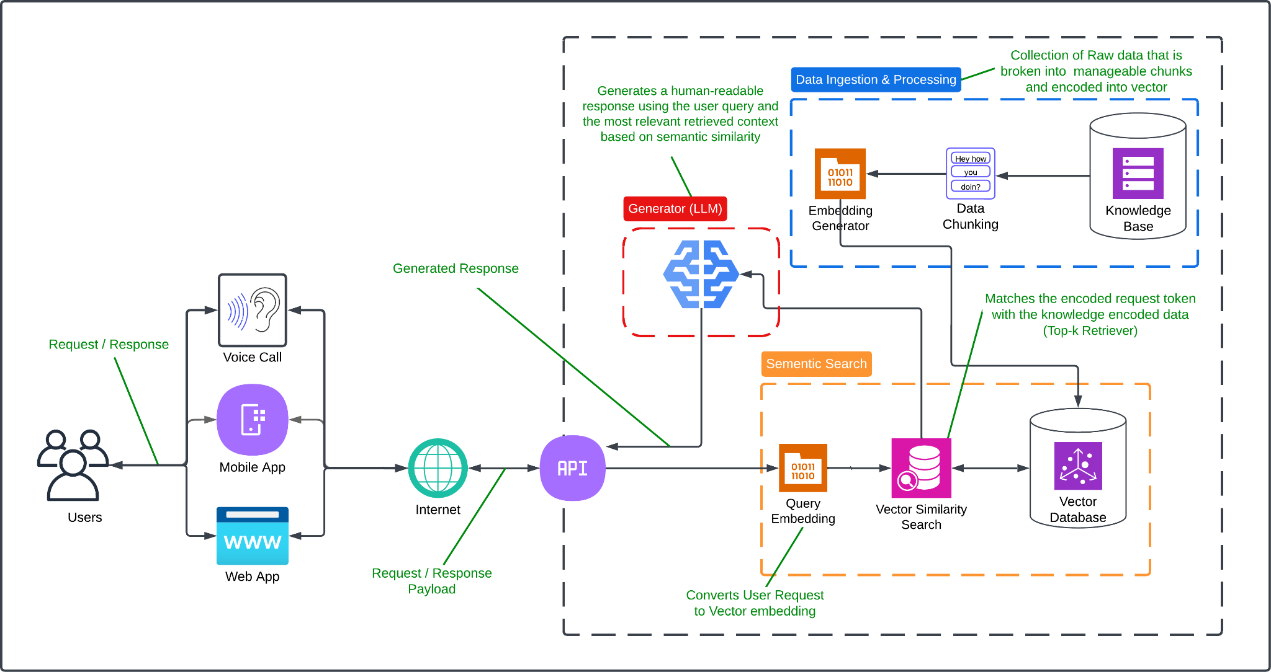
SnapRoot
AI Architecture
SnapRoot AI Architecture
Tech Stack
AI Models
Embeddings
Vector Database
Langchain
Knowledge Base

Slide 6
Demo

Slide 7

SnapRoot - Who
WHO: Profiles (Personalization Layer)
Household profiles (multiple people: kids, seniors, adults)
Dietary restrictions (allergies, halal, kosher, vegetarian, etc.)
Health conditions (diabetes, hypertension, low sodium, etc.)
Cooking constraints (limited appliances, physical ability, time)
Language preference
Cultural food preferences
SNAP account linking

Slide 8
SnapRoot - What
WHAT: Buy – Shopping Help
Multi-lingual - Multiple languages and translations supported
Omni-Channel - Mobile, web, voice
Budget grocery lists auto-generated from recipes
Mark SNAP-eligible items clearly
Pantry-stocking suggestions (short- and long-term)
Indicate lowest-cost versions of ingredients
“Essentials under $X” shopping shortcuts

Slide 9
SnapRoot - Where
WHERE: Shop – Local & Discount-Aware
Store locator: SNAP/WIC-accepting stores nearby
Food pantry & WIC site finder
Discount/coupon integration (from SNAP/Propel or local grocers)
Store-aware inventory suggestions (where possible)
Map or ZIP-based sorting

Slide 10
SnapRoot - Why
WHY: Understand – Nutrition Guidance
Daily calorie targets personalized per profile
Macronutrient balance (protein, fats, carbs)
Vitamin and mineral breakdown (basic level only)
Simple Q&A chatbot for nutrition questions
“Better choice” nudges (e.g. swap for lower sodium)

Slide 11
SnapRoot - How
HOW: Cook – Recipes & Use-What-You-Have
Cheap, nutritious recipes with prep-time and diet filters
“Cook with what’s in your pantry” feature
Quick meal suggestions by ingredient
Save recipes to auto-generate shopping list
“Prep level” tags (microwave-only, no-cook, one-pan)

Slide 12
Appendix

Slide 13






Slide 14
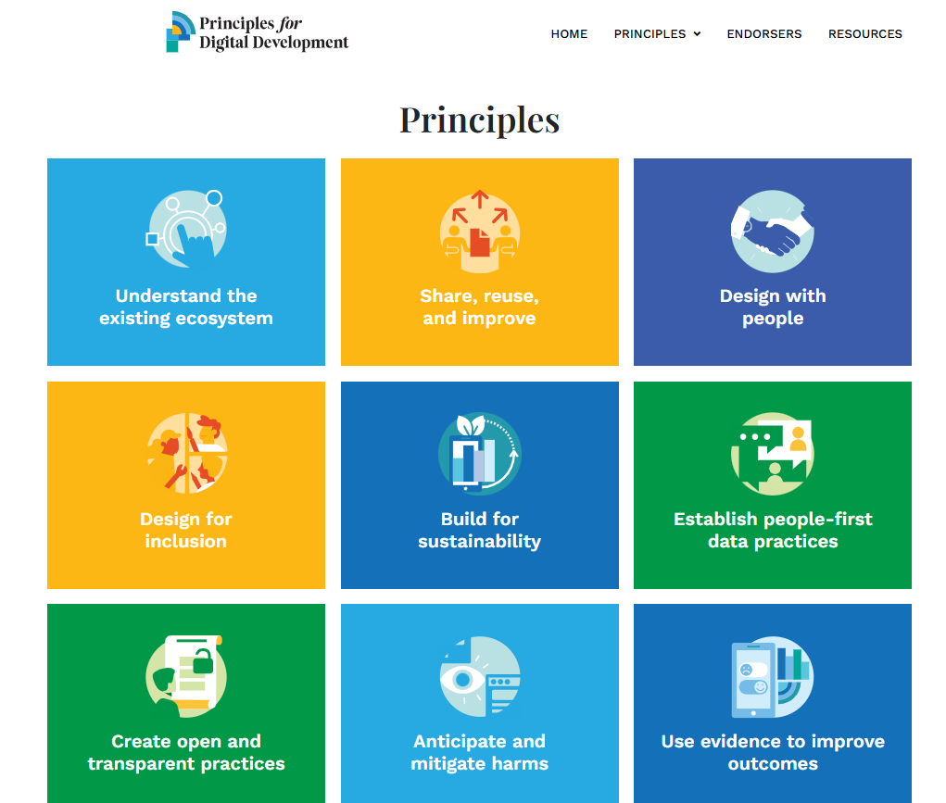
Principles of Digital Development

Slide 15
Current tools that exist but don’t meet the needs of our problem statement:
Propel
WIC app
MyFitnessPal
SnapEd Connection

Slide 16
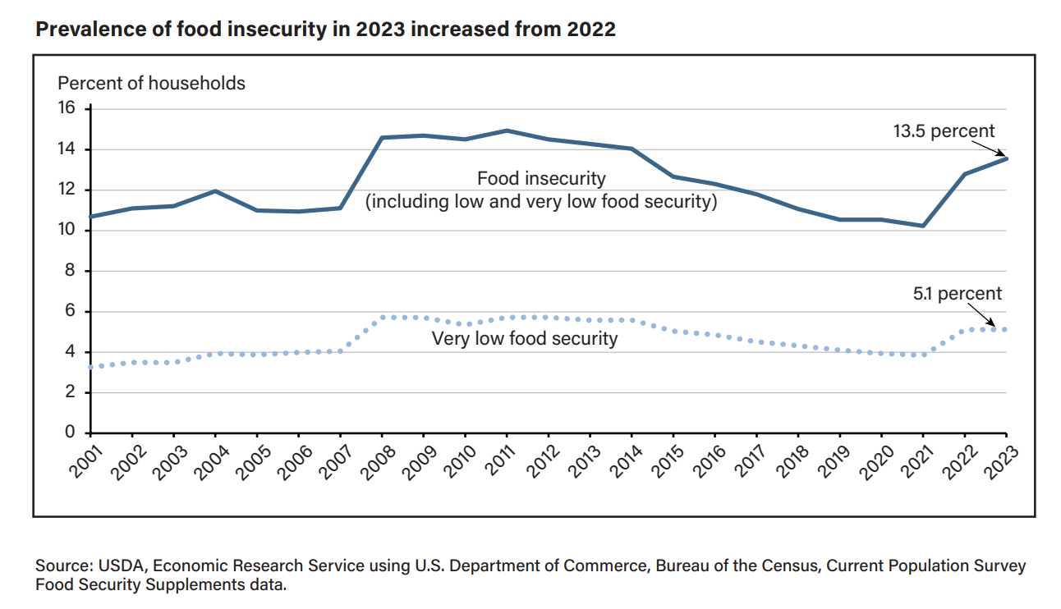
Household Food Security in the United States
in 2023,
USDA,
September 2024

Slide 17
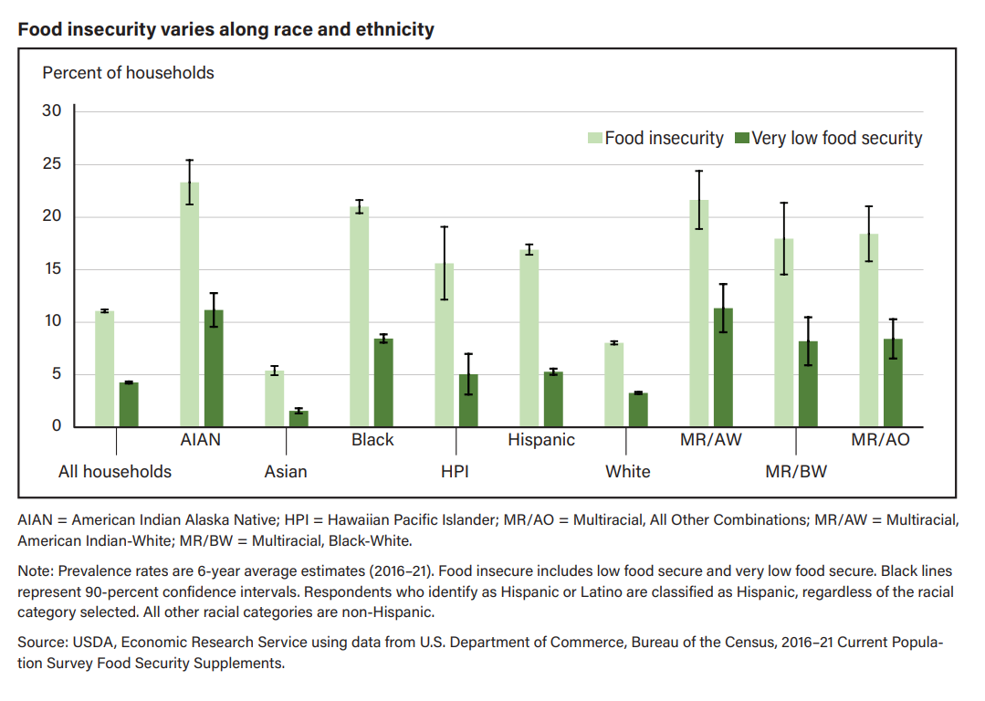
Household Food Insecurity Across Race
and Ethnicity in the United States, 2016–21
USDA,
April 2024

Slide 18
Disclaimers
Collaboration note: We prioritize ongoing engagement with SNAP participants, community organizations, and nutrition experts to ensure the solution is culturally relevant, practical, and respectful. Accessibility note: The solution is designed for low digital literacy and varied technology access, including voice and phone adaptability to reach users without smartphones or reliable internet. Transparency note: We commit to clear communication about data use, privacy, and how recommendations are generated to build trust and user confidence. Agility note: We embrace iterative development, welcoming feedback and rapidly refining the solution to better meet user needs throughout the hackathon and beyond.

Slide 19
Supporting Citations for problem statement
Dietary restrictions (medical, cultural, religious) Feeding America (2022): “Families experiencing food insecurity are more likely to have chronic diseases requiring dietary management.” https://www.feedingamerica.org/hunger-in-america/impact-of-hunger
Lack of tailored guidance National Academies of Sciences (2019): “Nutrition assistance programs often fail to provide personalized or culturally relevant dietary guidance.” https://nap.nationalacademies.org/catalog/25352
Low digital literacy and tech access Pew Research Center (2021): “Low-income adults are less likely to own a smartphone or have consistent access to broadband internet.” https://www.pewresearch.org/internet/fact-sheet/internet-broadband/ SNAP Provides Critical Benefits to Workers and Their Families
Center on Budget and Policy Priorities (CBPP, 2020): “SNAP also plays an important role in supplementing workers’ low or fluctuating wages or helping them during periods of unemployment.” https://www.cbpp.org/research/food-assistance/snap-provides-critical-benefits-to-workers-and-their-families

Slide 20
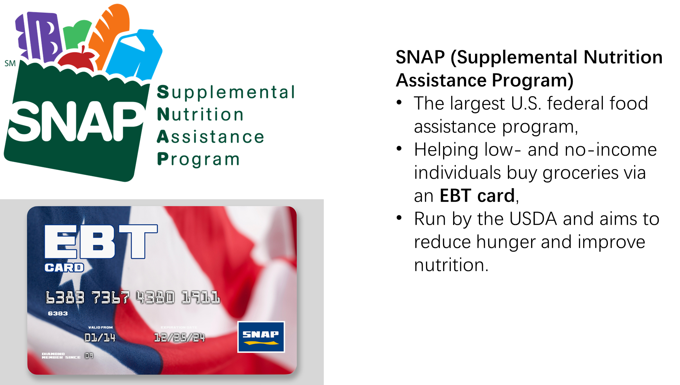
What is SNAP ?

Slide 21
Thank you!!
Terry Fei
Selina Fung
Maureen Naff
Bhavin Goswami
Will Liu

Slide 22
